Slide 1
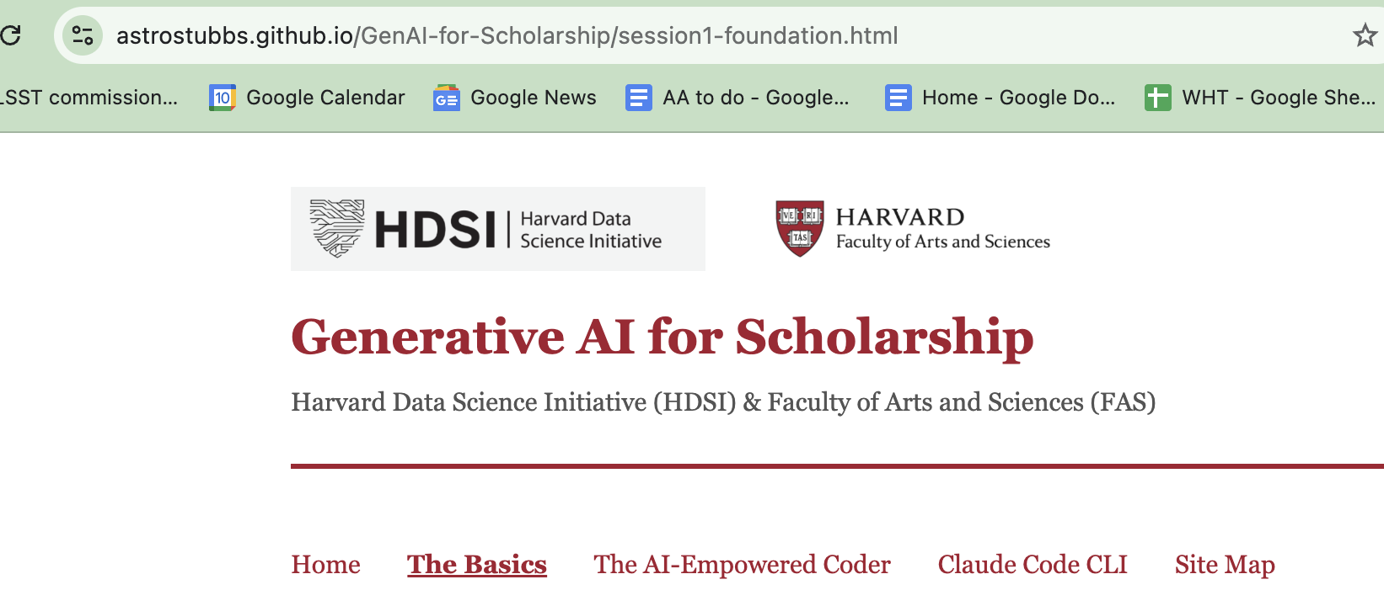
Welcome!

Slide 2
What’s Generative AI?
A suite of tools (ChatGPT, Claude, Gemini, etc.) that are trained on an extensive corpus of information (text, images, etc.) and can make a statistical prediction of next-word in a sequence.
The dog that I saw was .
Simple, right? Well…. maybe not.
ChatGPT was released Nov 2022. Caught nearly everyone off-guard.
Explosive growth in capabilities of GAI models, ever since.
Unless you’ve tried cutting edge GAI tools in the last month, your impressions are out of date and irrelevant.

Slide 3
Characteristics of GAI systems
Output is not repeatable; it depends on training data, uploaded additional information, and prior “context”.
Information is mapped into an “embedding” vector space, nearby concepts are close together in that space.
This abstract representation facilitates multimodal conversion of information: text to images, video to text, audio to text, English to French, etc.
But… computer programs produced by GAI do give reproducible outputs.
One of our challenges is to validate and verify GAI-produced output, including computer programs.

Slide 4
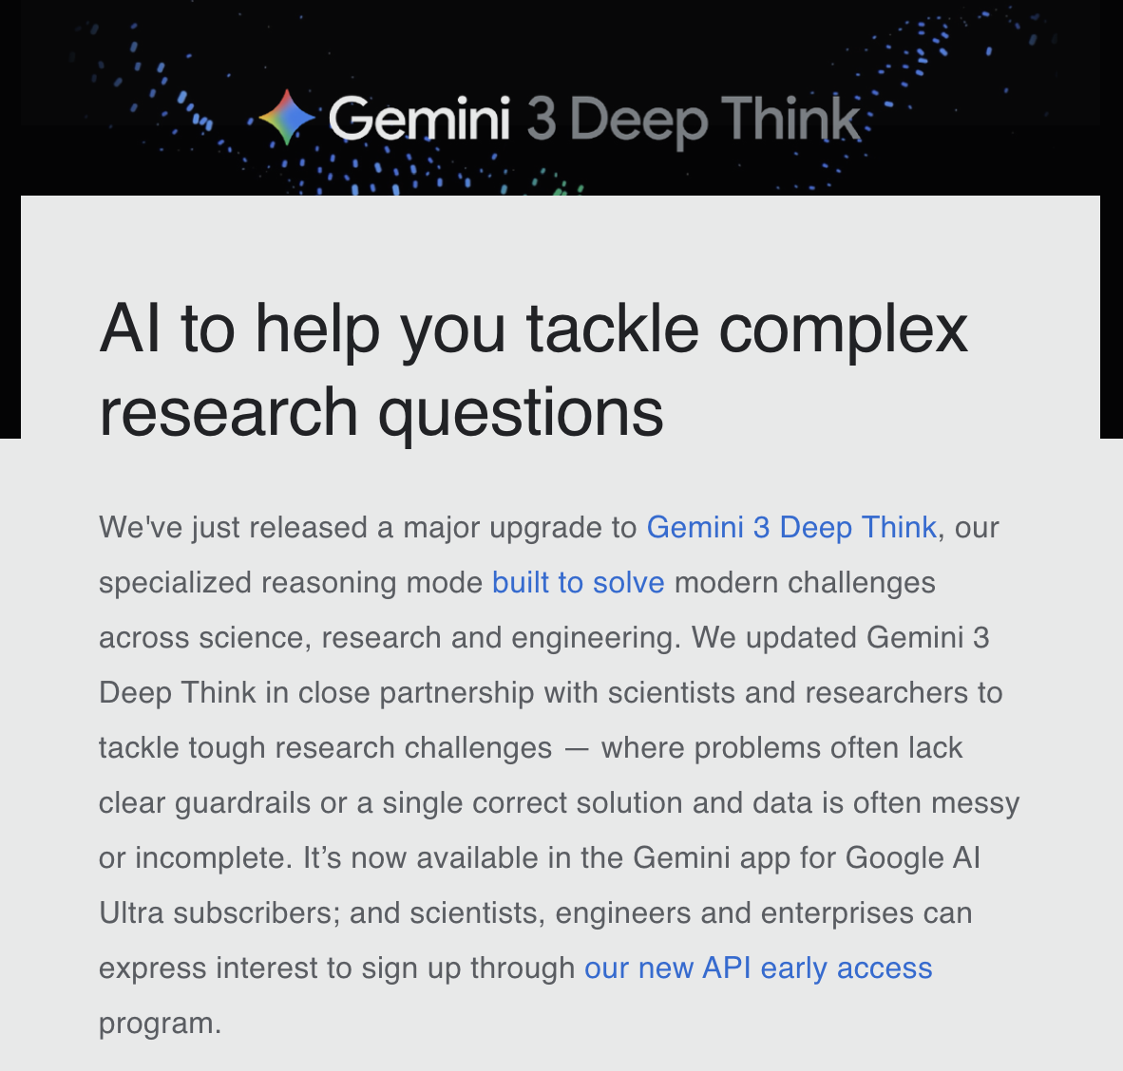
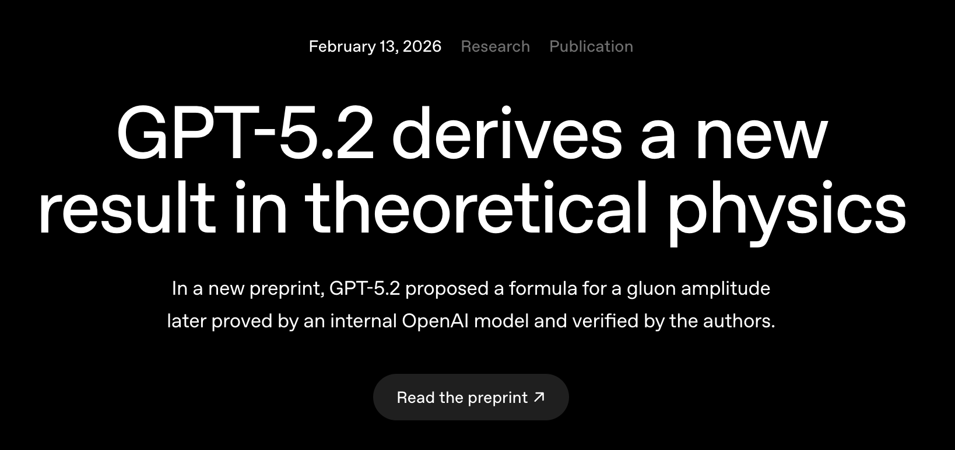
AI is changing how we do research
Feb 14, 2026

Slide 5
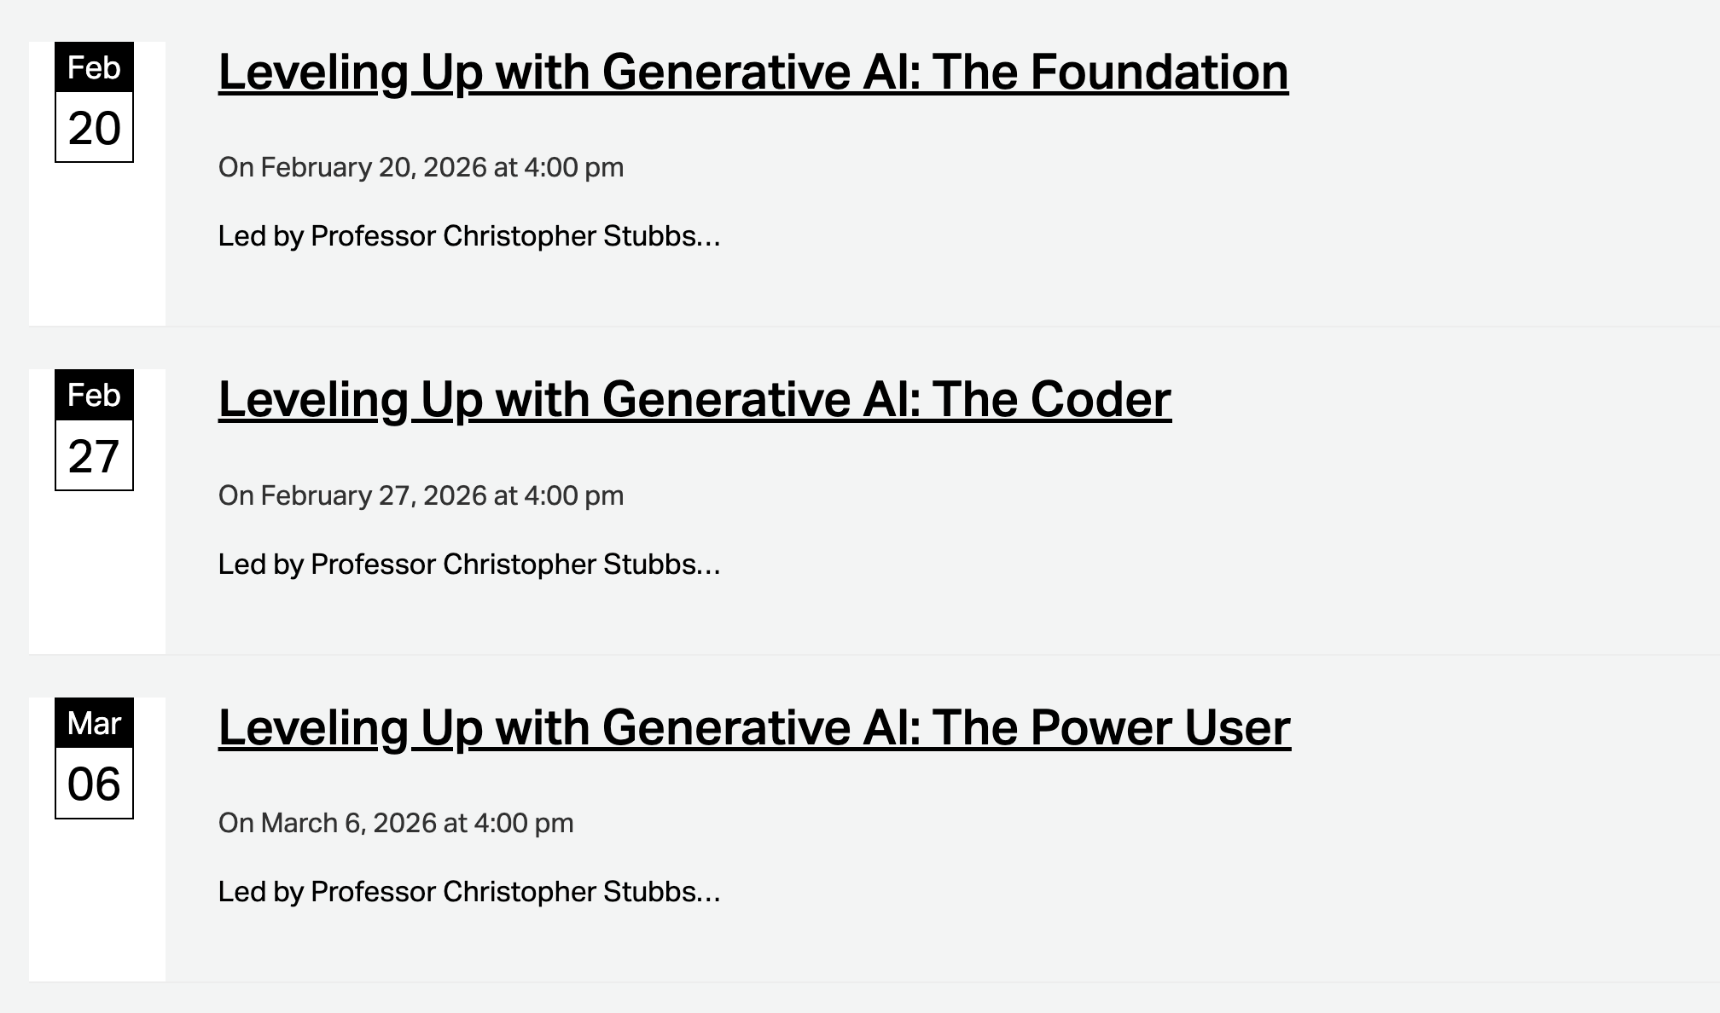

Slide 6
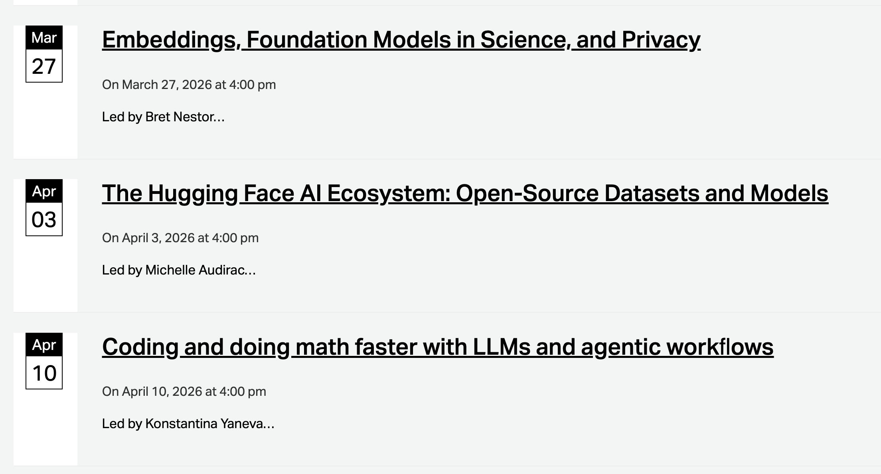

Slide 7
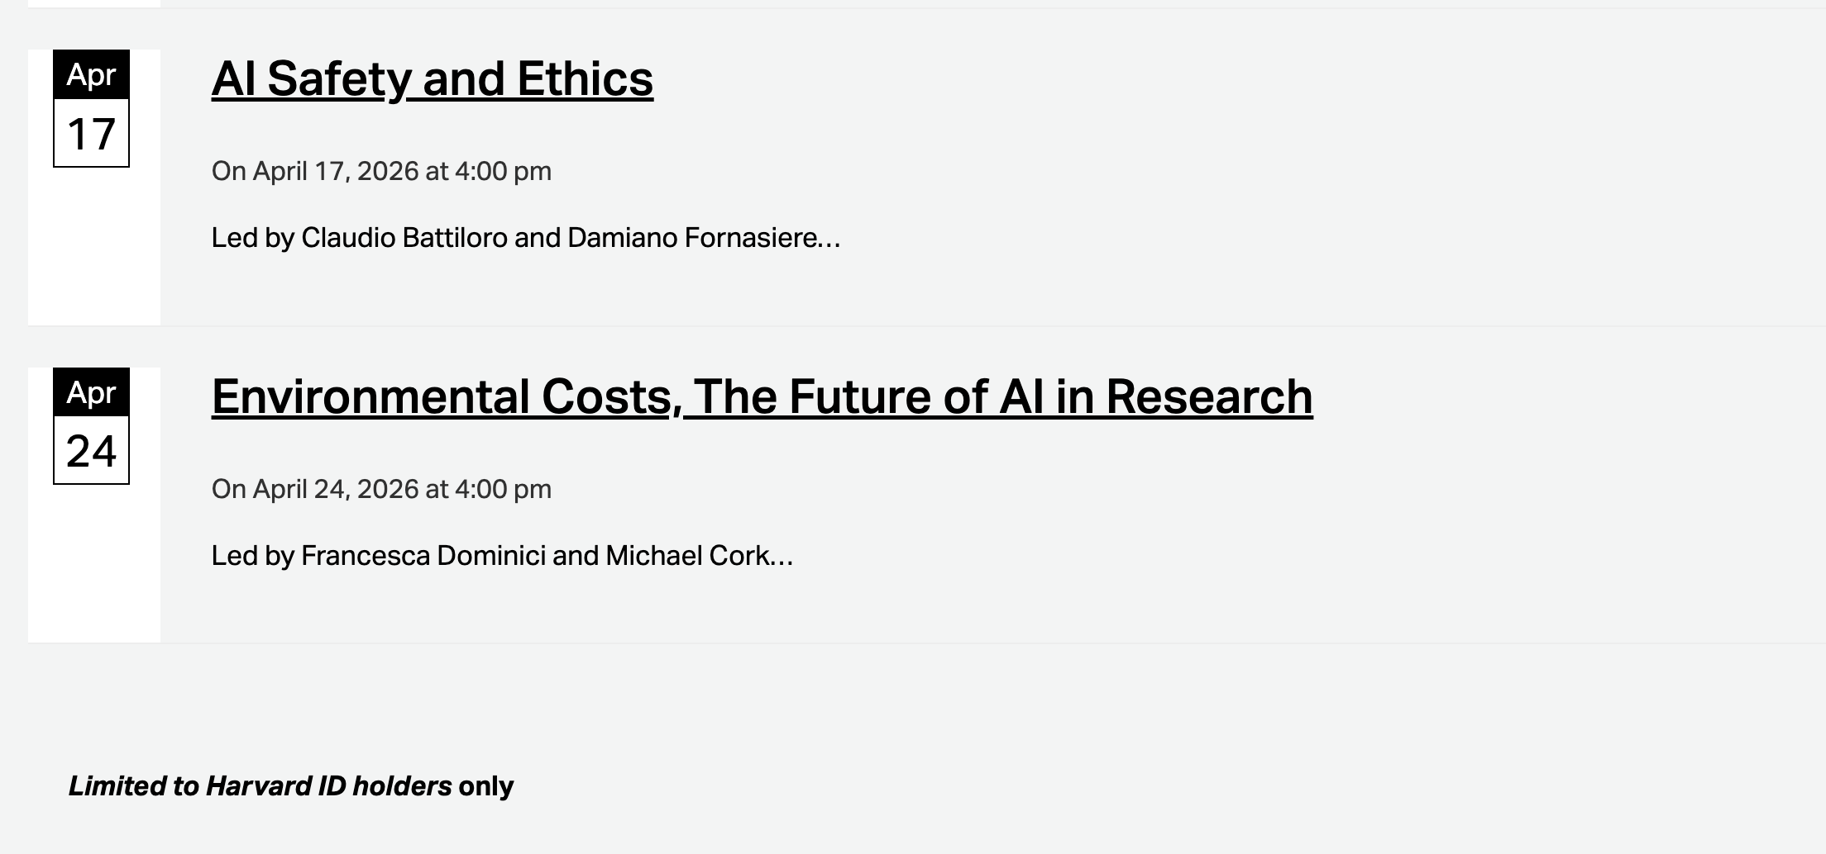

Slide 8
Quadrants of competencies
GAI proficiency required to remain competitive and reap the benefits of this technology
high
Domain
Expertise required for asking the right questions and for validation & verification
low
high
low

Slide 9

QR code for all 8 sessions
Sign up!

Slide 10
Tool | Primary Function | Context (base level) | Privacy | Illustrative Use
Gemini | Chat | 32K ~50 pages | Private, one user | Multimodal AI tool, image generation, tutor, general queries.
NotebookLM | Querying and summarizing documents | 50 sources < 200MB per file | Private by default, sharable | Gives links to locations in docs as part of response. Private resource library
Gemini Gems | Customizable! | 32K | Private to user, sharable | Anything with a persistent, customized prompt- exam prep, policy checks….
GAI in IDE: Cursor, Windsurf, VScode | Software development | NA | Live-share options exist. | Programming
Colab Python notebook + AI | Python development, data analysis | 32K | Notebook sharing | Data analysis Data browsing & visualization Code generation and debugging
Claude Code Command Line interface | Agentic Workflow on your laptop | 200K tokens | Local execution | Problem solving! Run on local data OS execution

Slide 11

Three initial sessions, five more after Spring Break
Session 1, Today: Google toolkit: Gemini, NotebookLM & Custom Gems
Session 2, Friday Feb 27: Integration of AI with Python notebooks
Session 3, Friday March 6: Claude Code command line interface.
Link for today’s home page:
https://bit.ly/3ZxtPw8

